Slide 1
Iron deficiency in pet animals
Dr. Mohamed M. Ghanem

Slide 2
Definition
A deficiency in iron results in the development of anemia (lower than normal number of red blood cells). In iron deficiency anemia, the size of each red blood cell and the amount of hemoglobin it contains are also reduced

Slide 3
Etiology
Reduced intake of iron in the diet
Puppies and kittens can be born with lower than normal stores of iron if their mothers did not receive adequate iron during pregnancy. Feeding supplemental iron to the mother while nursing can not make up for this lack of reserves since this treatment does not increase the iron content of the milk. Puppies and kittens with this condition often develop iron deficiency anemia during the nursing period

Slide 4
Pathogenesis
As its primary function, iron combines with Copper (Cu) and protein to form hemoglobin, the molecule in red blood cells that carries oxygen.
Iron also is necessary for certain enzymes in the body to function normally

Slide 5
Clinical symptoms
symptoms of anemia include decreased growth rate, weakness, and increased susceptibility to stress or disease.
Animals with iron deficiency may also develop constipation.

Slide 6
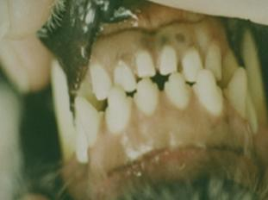
Pale oral mm in a dog due to anaemia

Slide 7
Diagnosis
Case history
Clinical signs
Lab diagnosis:
complete blood picture
Determination of iron level in serum

Slide 8
Treatment
Iron supplementation with intramuscular injectable iron in iron deficient patients is useful (iron dextran)

